Slide 1


Stacking stools at a local noodle shop on Cheung Chau Island, HK
ENHANCING STUDENT & CLIENT SUCCESS THROUGH
DESIGN THINKING, TEACHING & TRANSLATION

Slide 2
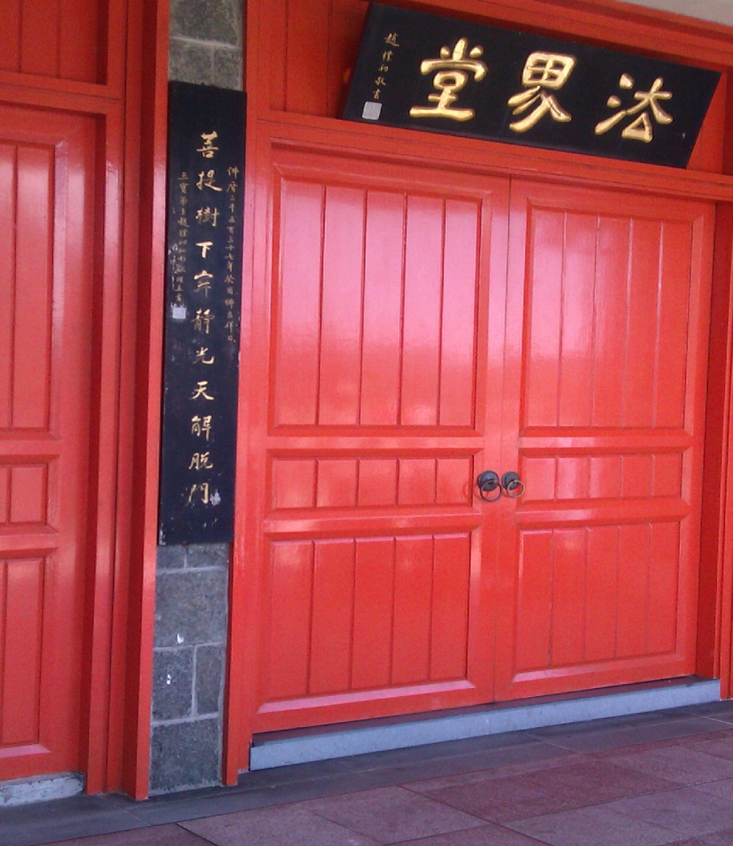
CHAFFEY COLLEGE
FUNDAMENTALS OF INTERIOR ARCHITECTURAL DESIGN
- AN INTRODUCTION
PROFESSION OF DESIGN
CHANGING FOCUS OF DESIGN
DESIGN SYSTEMS THINKING
HOW DID WE GET HERE?
GLOBAL CITIZENSHIP & SOCIAL JUSTICE
HOW WE TOUCH & CHANGE LIVES
Doors at Giant Buddha, Lantau Island, HK

Slide 3

FUNDAMENTALS OF INTERIOR ARCHITECTURAL DESIGN - AN INTRODUCTION
EXERCISE – REFLECTION
What is the single most bothersome functional issue you have with your living place?
Using this room as a comparison, estimate how much living space you and your family must have to be comfortable (smaller, 2x, 3x, …)?
How many people live with you?
Reflection lily ponds under the ArtScience Museum,
Singapore designed by Moshe Sofdie

Slide 4
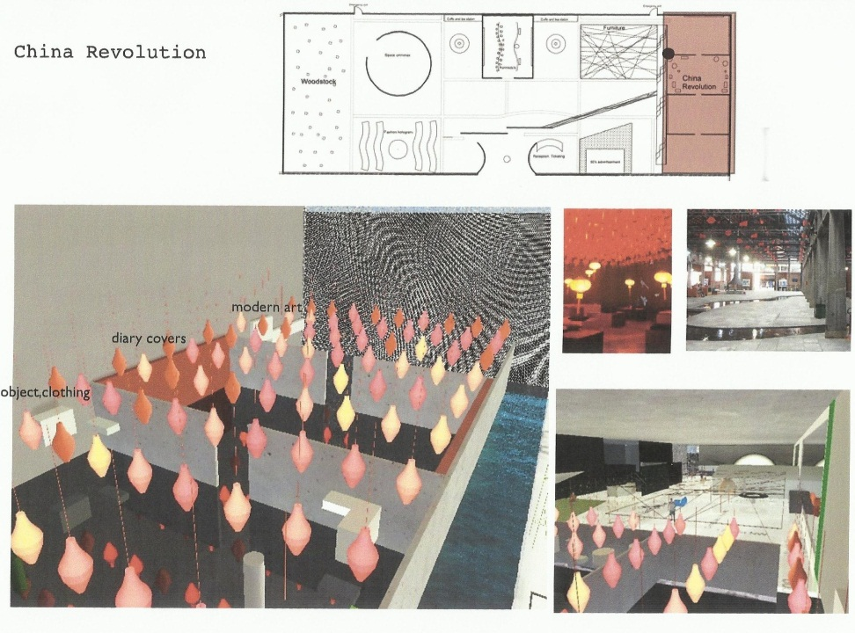
PROFESSION OF DESIGN
FUNDAMENTALS OF INTERIOR ARCHITECTURAL DESIGN - AN INTRODUCTION
IFI INTERIORS DECLARATION
Global Symposium - February 2011 Establishing Advancement of Interior Architecture/Design Worldwide
Co-sponsored by Cooper Hewitt National Design Museum, Smithsonian Institution, and Museum of Arts and Design
100 symposium delegates, 30 countries from the world’s leading design authorities, innovators, business leaders and strategic thinkers
M+ W. Kowloon Cultural Center, HK 1960 Art Exhibit
student Tunde Lendvai

Slide 5

PROFESSION OF DESIGN
FUNDAMENTALS OF INTERIOR ARCHITECTURAL DESIGN - AN INTRODUCTION
IFI INTERIORS DECLARATION
“It is the nature of human kind not only to use space, but to fill them with beauty and meaning.
Skillfully designed spaces can arouse in us a sense of purpose, or a sense of the profound.
In the spaces that are important to us, we experience not only a sense of place, but a sense of who we are, and of what we can be.
Thoughtfully designed spaces help us learn, reflect, imagine, discover and create.”
Central Guangzhou Mainland China

Slide 6


PROFESSION OF DESIGN
FUNDAMENTALS OF INTERIOR ARCHITECTURAL DESIGN - AN INTRODUCTION
IFI INTERIORS DECLARATION continued
“Great spaces are indispensable for creative cultures. They encourage connections between people, ideas and entire fields of thought.
As design professionals, our knowledge enables us to form spaces that respond to human needs. These human spaces are the domain of our competence, our passion and our work.
We use space responsibly. We practice our profession with highest regard for engaging the world’s economic and natural resources in a sustainable manner. We design for health, safety, well-being and the needs of all.”
Ozone Ritz Carlton Hong Kong 118 Floor

Slide 7
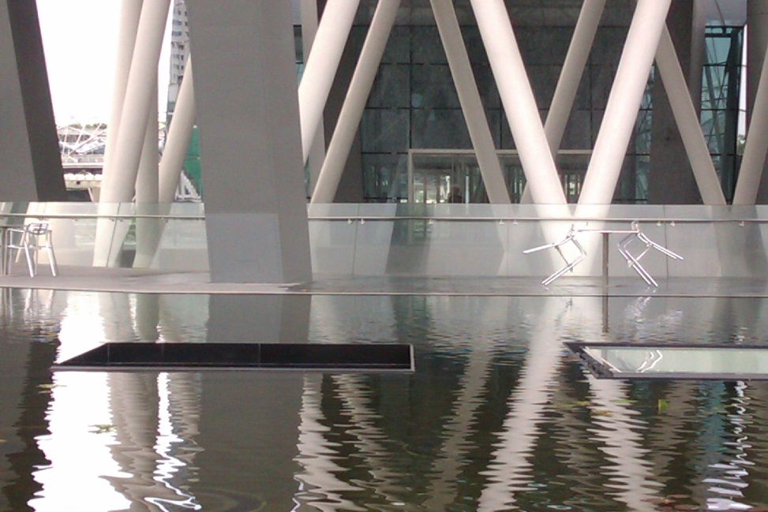
PROFESSION OF DESIGN
FUNDAMENTALS OF INTERIOR ARCHITECTURAL DESIGN - AN INTRODUCTION
IFI INTERIORS DECLARATION continued
“It is, after all, for humanity, our ultimate client, that we design. We shape the spaces that shape the human experience.
This is what we do, what we create, what we give.
It is how we earn our place at the human table.
It is why our work is important to our clients, to our societies and to ourselves.
It is the difference we make and why we choose this noble profession.”
ArtSience Museum, Singapore designed by Moshe Sofdie

Slide 8
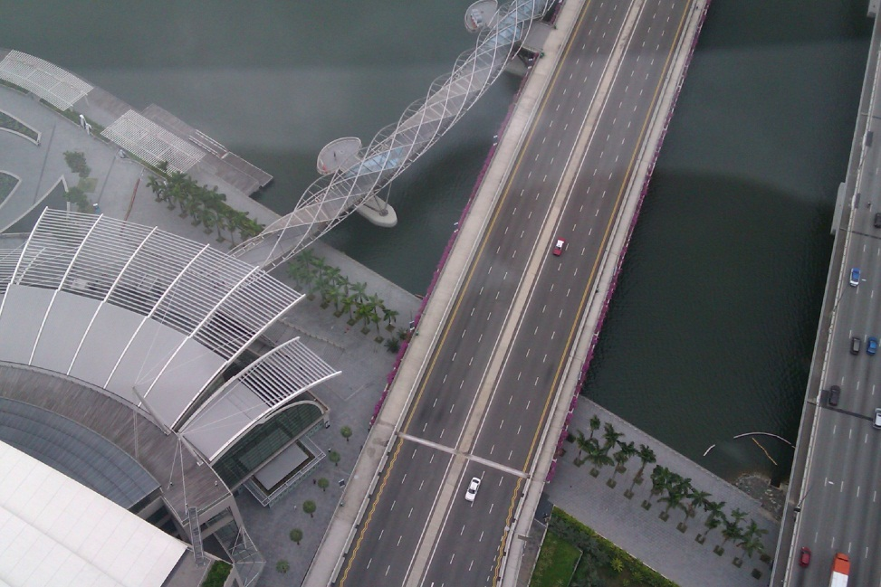
CHANGING FOCUS OF DESIGN
FUNDAMENTALS OF INTERIOR ARCHITECTURAL DESIGN - AN INTRODUCTION
Historically, the designer’s role has been associated with elite societies now outside the current value shifts.
Our style of consumption has led to devastating consequences for our planet.
Global warming, toxic waste and
quality of life inequalities threaten our very existence.
Nearly 50% of the total US greenhouse gas emissions are attributed to the building sector alone.
Singapore view from the giant wheel

Slide 9
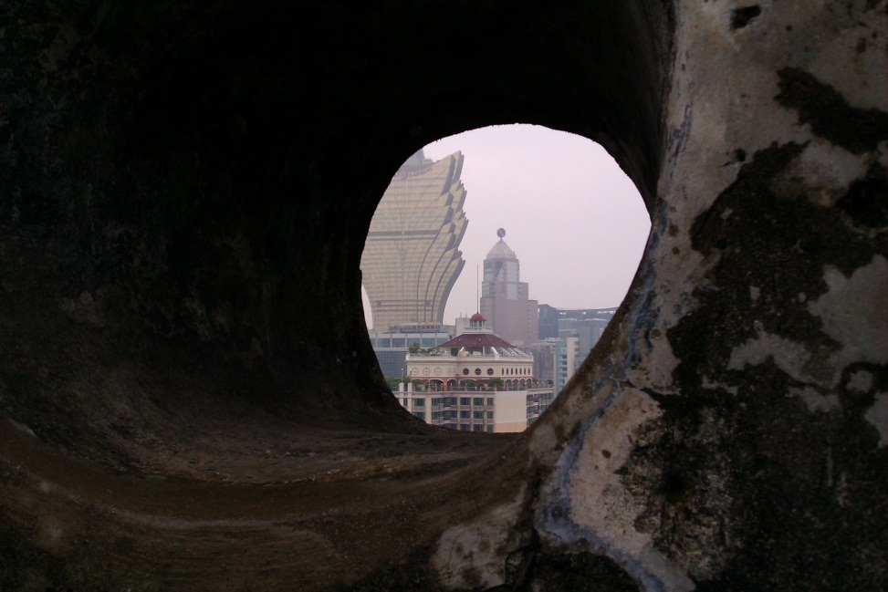
CHANGING FOCUS OF DESIGN
FUNDAMENTALS OF INTERIOR ARCHITECTURAL DESIGN - AN INTRODUCTION
YOU, the next generation of designers, have a responsibility to reduce emissions by rethinking cycles of production and consumption.
WE must remind ourselves we are not only going to be designers but are consumers and voters with both professional and personal influence.
Macau view from fort

Slide 10

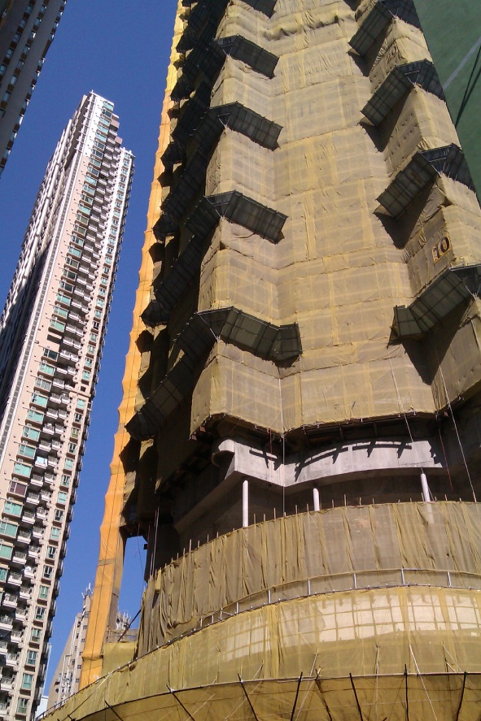
CHANGING FOCUS OF DESIGN
FUNDAMENTALS OF INTERIOR ARCHITECTURAL DESIGN - AN INTRODUCTION
Flower Bogota, Six Banyan Trees 1097,1373AD, restored 1900 Guangzhou China
New luxury skyscraper apartment under construction Wan Chai ,HK

Slide 11
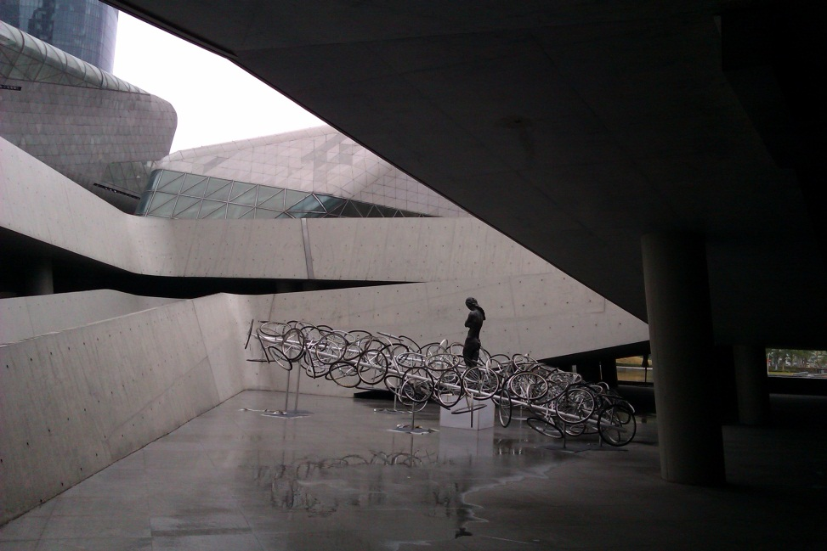
CHANGING FOCUS OF DESIGN
FUNDAMENTALS OF INTERIOR ARCHITECTURAL DESIGN - AN INTRODUCTION
“This is the contradictory desire in our utopia. We want to live in a small community with which we can identify and yet we want all the facilities of the city of millions of people. We want to have very intense urban experiences and yet we want open space right next to us.”
Moshe Sofdie - architect
Guangzhou Opera house designed by Zaha Hadid

Slide 12

DESIGN SYSTEMS THINKING
FUNDAMENTALS OF INTERIOR ARCHITECTURAL DESIGN - AN INTRODUCTION
Is human centered; relies on our ability to be intuitive, recognize patterns, construct ideas having emotional meaning and are functional, expressing ourselves
Process of overlapping spaces rather than sequence of orderly steps
  Inspiration - the problem or opportunity motivating the search for solutions
  Ideation - generating, developing and testing ideas
  Implementation - leading to project stage and into people’s lives
Incense burning in Buddhist Temple

Slide 13
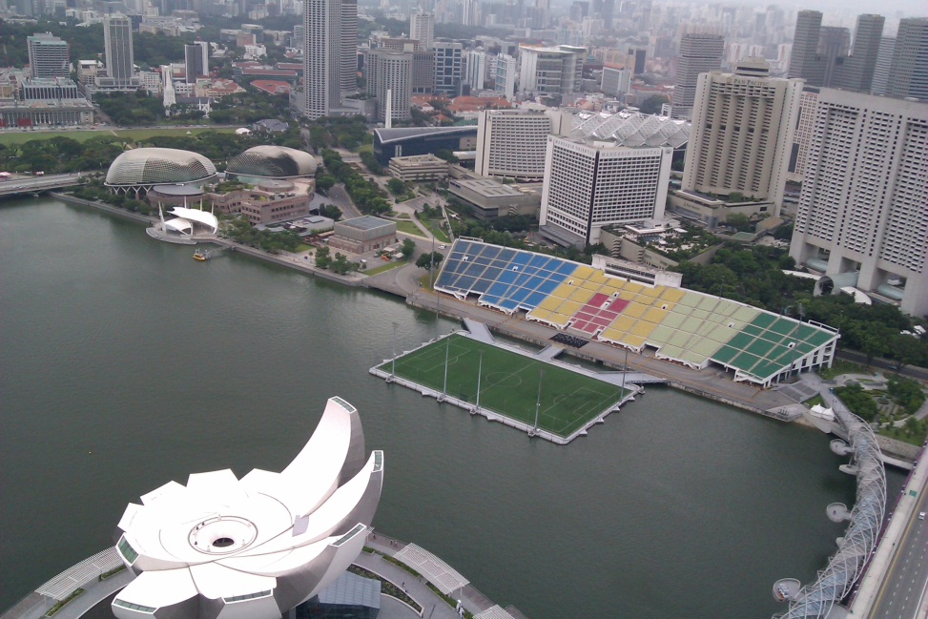
DESIGN SYSTEMS THINKING
FUNDAMENTALS OF INTERIOR ARCHITECTURAL DESIGN - AN INTRODUCTION
Observations:
Inspiration, ideation and implementation steps are not always sequential
Projects may loop back more than once as you refine ideas and explore new direction
May feel chaotic
Process allows for serendipity, unpredictability and whims of fate
Waterfront in Singapore with Artsscience museum

Slide 14

DESIGN SYSTEMS THINKING
FUNDAMENTALS OF INTERIOR ARCHITECTURAL DESIGN - AN INTRODUCTION
Interior architectural design studio class embedded in the traditions of creative problem solving
Student’s responsibility - to explore problems without known results
  Experience personal process of discovery
Instructor’s responsibility - to map a sequence of smaller steps towards a broader vision
  Facilitate frameworks to a larger global approach to change
My 32 m apartment – a 30 year transformation

Slide 15
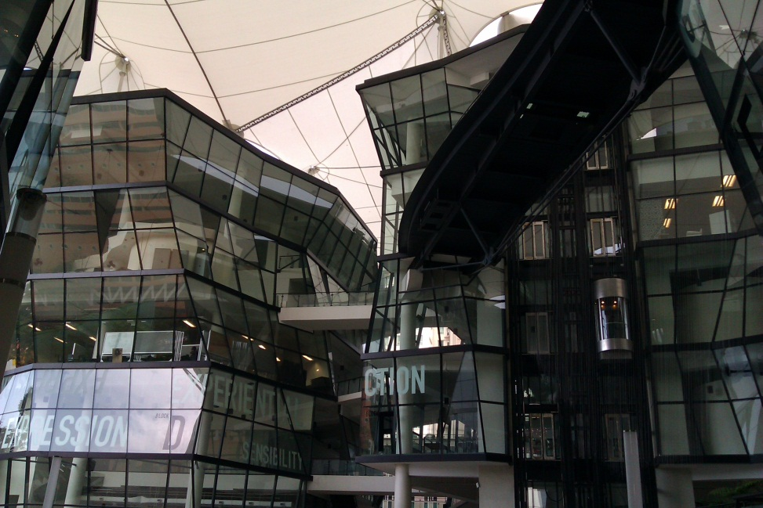
DESIGN SYSTEMS THINKING
FUNDAMENTALS OF INTERIOR ARCHITECTURAL DESIGN - AN INTRODUCTION
“The experienced, creative designer withholds judgment,
resists preconceived solutions and
the pressure to synthesize until all the information is in. He/She refuses to make sketches until he/she knows the clients problem…”
William Pena, Steven Parshall
and Keven Kelly - 1987
LaSalle College of Arts Singapore

Slide 16

HOW DID WE GET HERE?
FUNDAMENTALS OF INTERIOR ARCHITECTURAL DESIGN - AN INTRODUCTION
MYTH OF AMERICAN SHELTER
“Most people would prefer to live in a single family detached home, and through hard work and thrift they could afford it. The reality is most people are different.”
Robert P. Gordon - 2011
Fact – With evolving family structures, economy difficulties, rising energy costs, crowded highways, and changing job locations, the goal of the single family dwelling is no longer feasible for most people.
Chinese New Year Display Wan Chai HK 2012

Slide 17
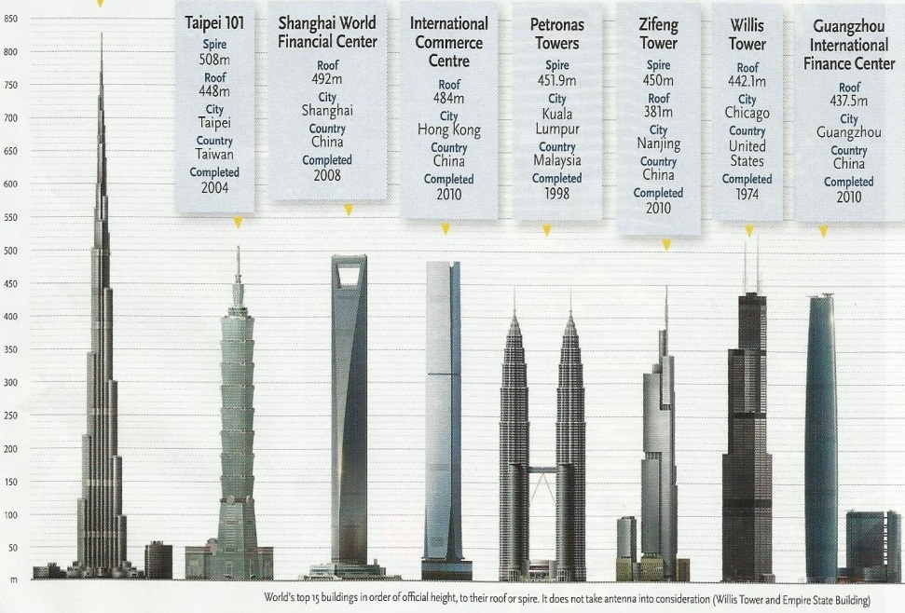
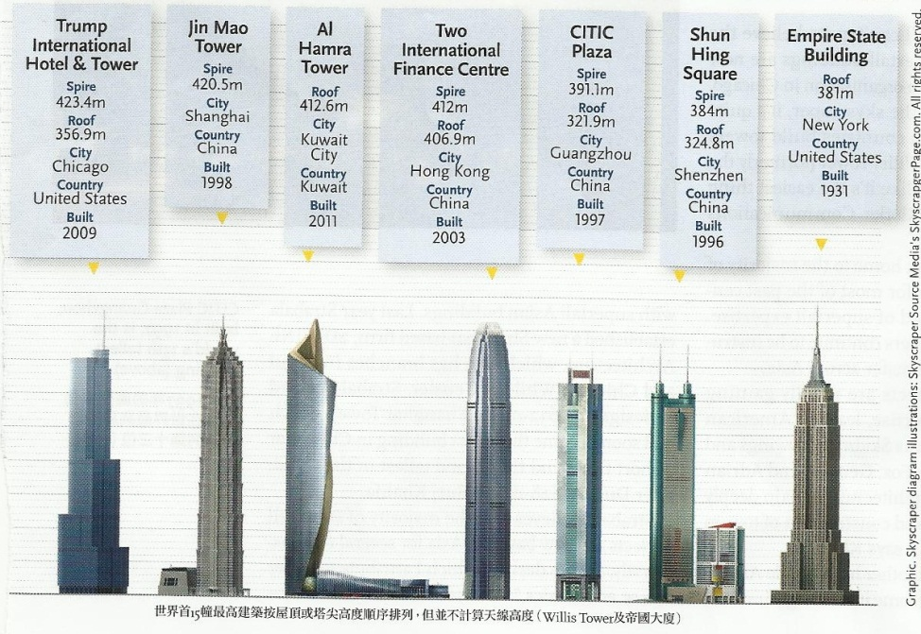
HOW DID WE GET HERE?
Globalization has led to the growth of population in large cities around the world. Two thirds of the world’s population are in Asia Pacific, 70% in cities.
FUNDAMENTALS OF INTERIOR ARCHITECTURAL DESIGN - AN INTRODUCTION
Some of the world’s most densely populated places (people per square mile):
Macau SAR 73,000
Hong Kong 72,000
Beijing 61,000
New York City 24,000
Singapore 18,000
Chicago 12,252

Slide 18
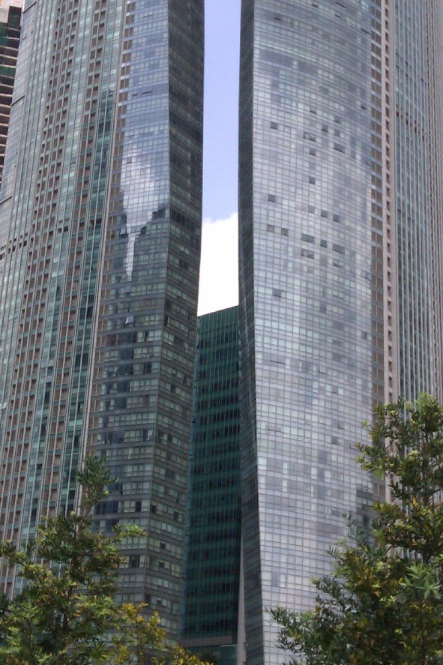
HOW DID WE GET HERE?
FUNDAMENTALS OF INTERIOR ARCHITECTURAL DESIGN - AN INTRODUCTION
US TREND
“Radical rearrangement in which people who possess money and choice are increasingly living in the center, while newcomers and poor settle in the suburbs.”
Alan Ehrenhalt –The Great Migration – Inversion of the American City, 2012
Guangzhou China skyscraper

Slide 19
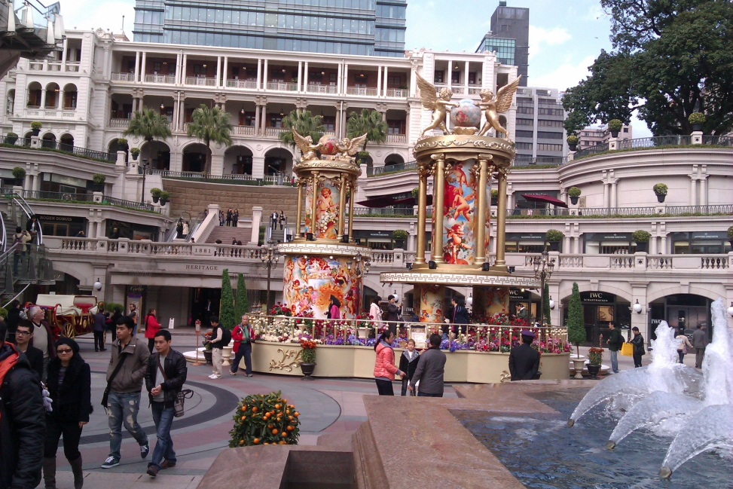
HOW DID WE GET HERE?
FUNDAMENTALS OF INTERIOR ARCHITECTURAL DESIGN - AN INTRODUCTION
CURRENT DEBATE IN ARCHITECTURE
Most design opportunities are in Asia, specifically China
Humanizing mega-scale due to population density or sculpture and persona celebrity architecture…
899: number of current interior architecture jobs listed in Hong Kong on
www. jobsDB.com.hk
Tsim Sha Tsui Hong Kong

Slide 20
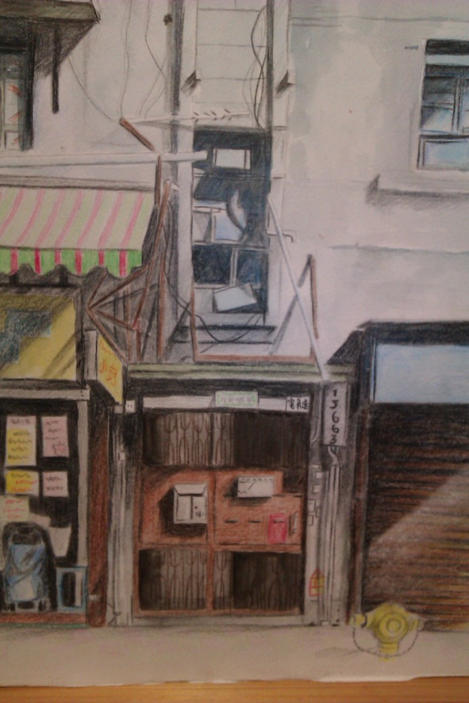
GLOBAL CITIZENSHIP & SOCIAL JUSTICE
FUNDAMENTALS OF INTERIOR ARCHITECTURAL DESIGN - AN INTRODUCTION
US STATE DEPARTMENT - 100,00 STRONG INITIATIVE
China: world’s largest population, largest middle class, 3rd largest economy
No major international issue --business, global security or climate change-- can be solved without the active engagement of US and China working together.
Mission strategic importance to US China relations
National effort designed to dramatically increase the number of American students studying in China
Currently there are 10 times more Chinese students studying in the US than American student studying in China
Endorsed by the AACC
“The Old Days in Hong Kong” art exhibit Tai Yau Plaza Hong Kong

Slide 21
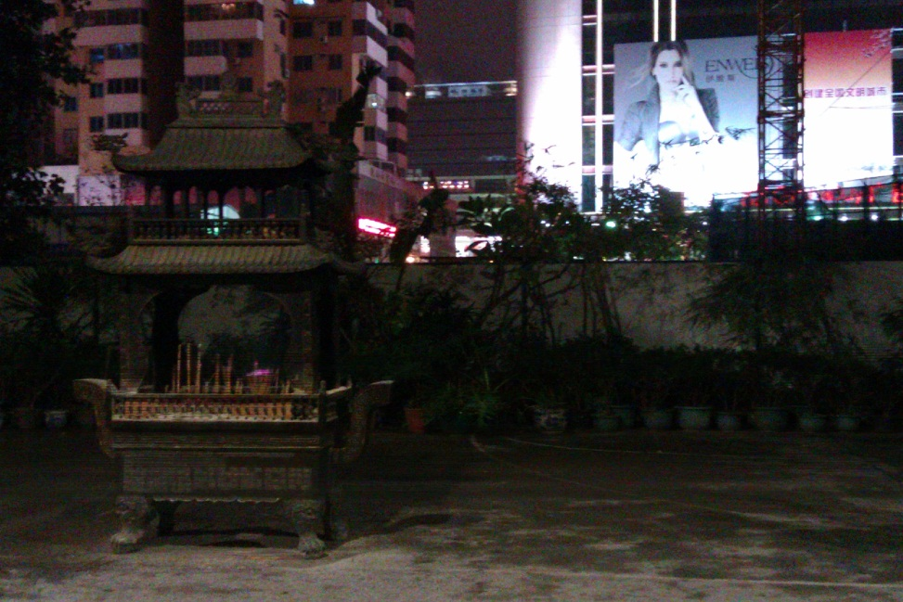
GLOBAL CITIZENSHIP & SOCIAL JUSTICE
FUNDAMENTALS OF INTERIOR ARCHITECTURAL DESIGN - AN INTRODUCTION
California Community College
- Global Citizenship Initiative
“To be a global citizen, one is knowledgeable of peoples, customs and cultures in regions of the world beyond one’s own: understands the interdependence that holds both promise and peril for the future of the global community; and is committed to combining one’s learning with a dedication to foster a livable sustainable world.” 2008
Guangzhou China

Slide 22
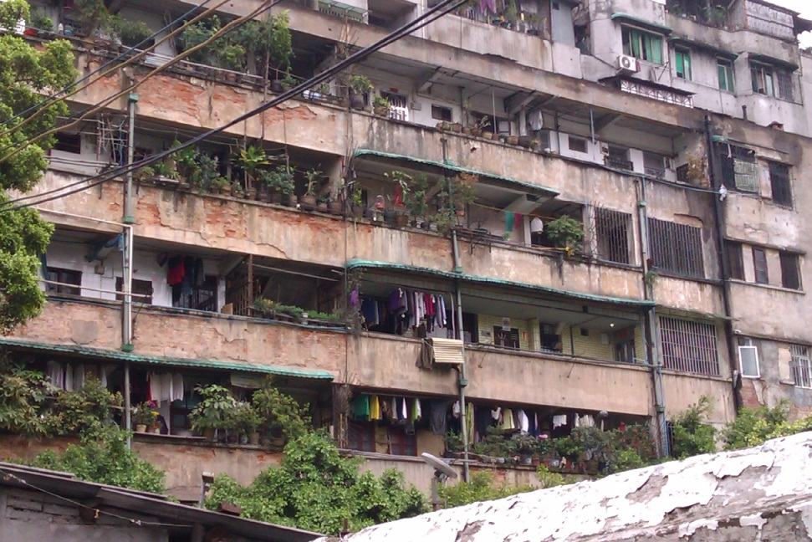
GLOBAL CITIZENSHIP & SOCIAL JUSTICE
FUNDAMENTALS OF INTERIOR ARCHITECTURAL DESIGN - AN INTRODUCTION
Global Citizenship Initiative
Poverty and wealth, want and waste:
the unevenness of globalization
  2012 annual theme
    “Rising tide of global influence continues to transform human societies and natural environments.
    The fight against poverty continues.
    The wealth-generation effects of globalization have disproportionately concentrated on the elite minority, leading to resentment by those left behind.”
Guangzhou China

Slide 23
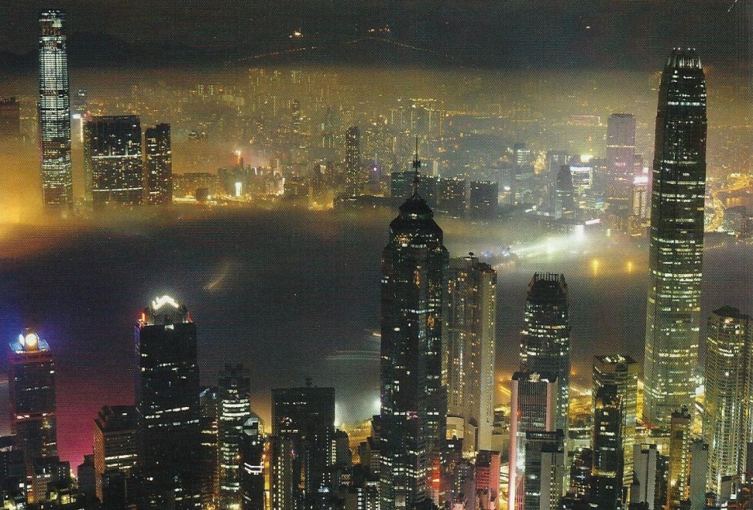
GLOBAL CITIZENSHIP & SOCIAL JUSTICE
FUNDAMENTALS OF INTERIOR ARCHITECTURAL DESIGN - AN INTRODUCTION
Hong Kong – westernized Chinese city, governed for 1.5 centuries under British rule
Small territorial space with large,
high density population
Highly urbanized, enjoying economic prosperity
World’s largest income disparities
Highest concentration of high-rise apartments for high-income households, also with impoverished households living on rooftops of old tenement buildings
Hong Kong, view from HK Island to Kowloon

Slide 24
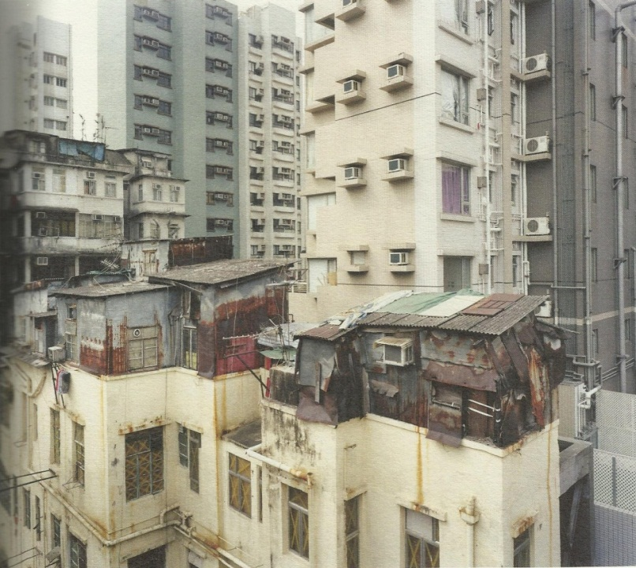
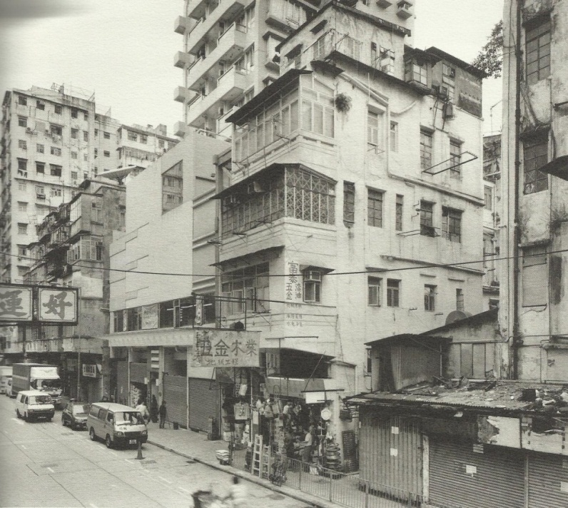
GLOBAL CITIZENSHIP & SOCIAL JUSTICE
HK INFORMAL ROOFTOP COMMUNITIES
FUNDAMENTALS OF INTERIOR ARCHITECTURAL DESIGN - AN INTRODUCTION
Sham Shui Poi Building Example 1 Hong Kong
Social Welfare Department looks after rooftop residents,
who are under-privileged, the unemployed, the sick,
older persons, new immigrants, welfare recipients,
mental patients and ex-prisoners
Many rooftop dwellers are creative, making good
use of their limited physical space and ingeniously
creating their own living spaces.
Perhaps it is one of the wonders of this Pearl City.

Slide 25
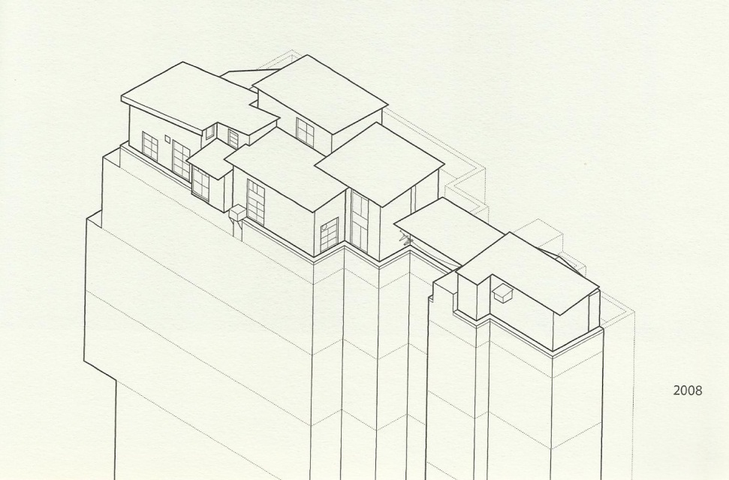
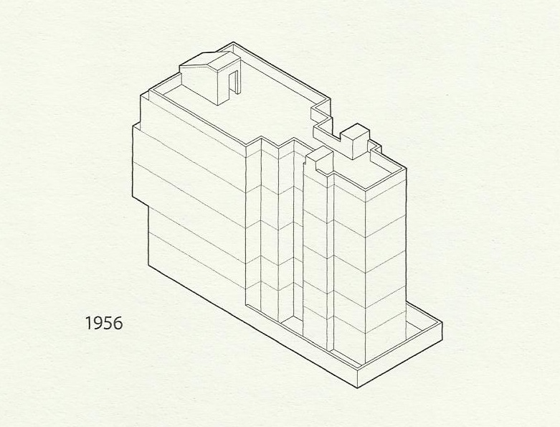
GLOBAL CITIZENSHIP & SOCIAL JUSTICE
HK INFORMAL ROOFTOP COMMUNITIES
Shan Shui Poi Building Example 1
FUNDAMENTALS OF INTERIOR ARCHITECTURAL DESIGN - AN INTRODUCTION
Drawings from Portraits From Above –Wu, Canham

Slide 26
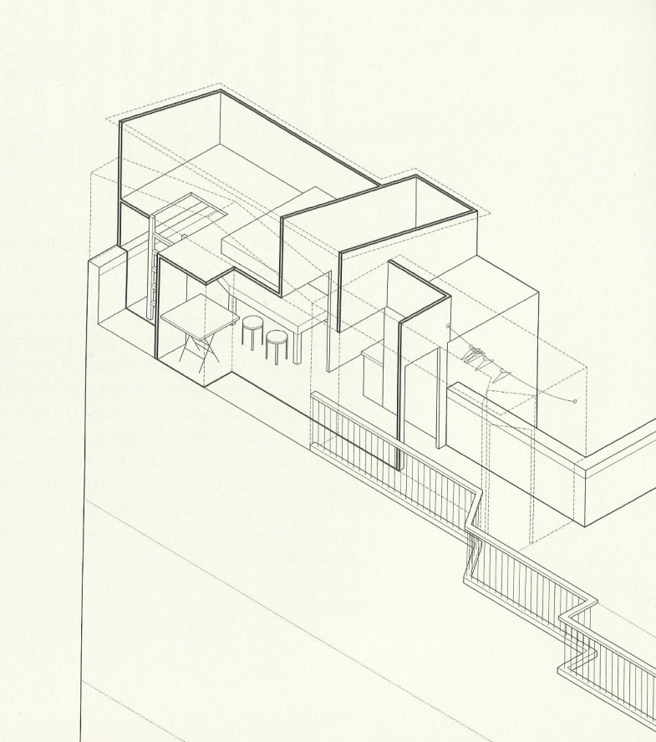
GLOBAL CITIZENSHIP & SOCIAL JUSTICE
HK INFORMAL ROOFTOP COMMUNITIES
FUNDAMENTALS OF INTERIOR ARCHITECTURAL DESIGN - AN INTRODUCTION
Shan Shui Poi Building Example 1
This flat is 194 sq. ft.
Houses new immigrant couple from Shenzhen
Monthly rent costs $103 US
There is no toilet; they utilize the
public lavatory down the block
Roof advantages – no need to share cooking facilities, more space to hang laundry, better ventilation
This woman’s secret to keeping her youthful look is the center piece of her living room: a computer controlled spa bed; it doubles as a storage shelf and table top
Drawings from Portraits From Above –Wu, Canham

Slide 27
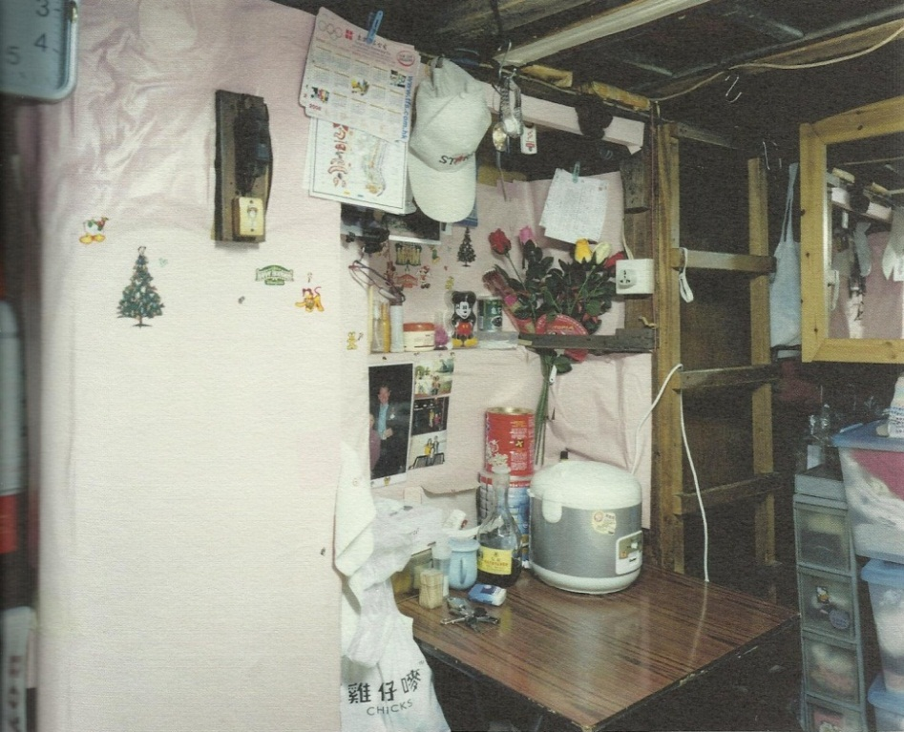
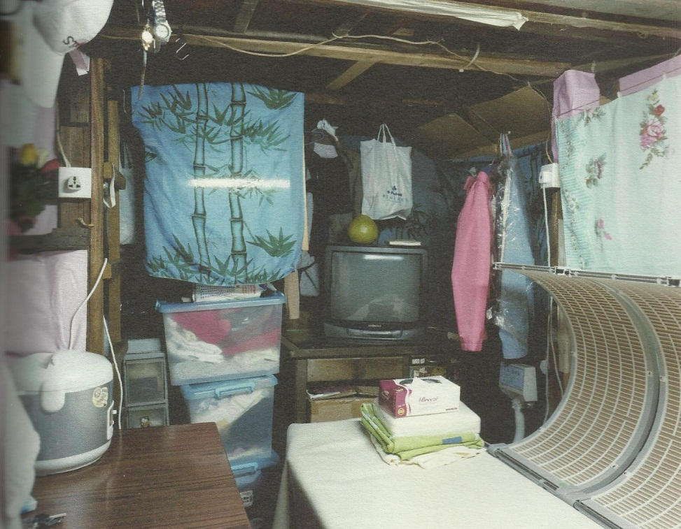
GLOBAL CITIZENSHIP & SOCIAL JUSTICE
HK INFORMAL ROOFTOP COMMUNITIES
Shan Shui Poi Building Example 1 continued
FUNDAMENTALS OF INTERIOR ARCHITECTURAL DESIGN - AN INTRODUCTION

Slide 28
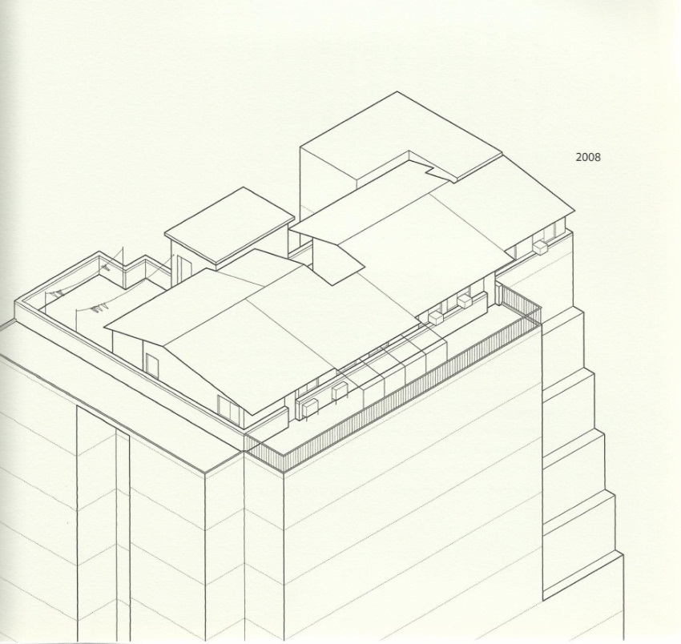
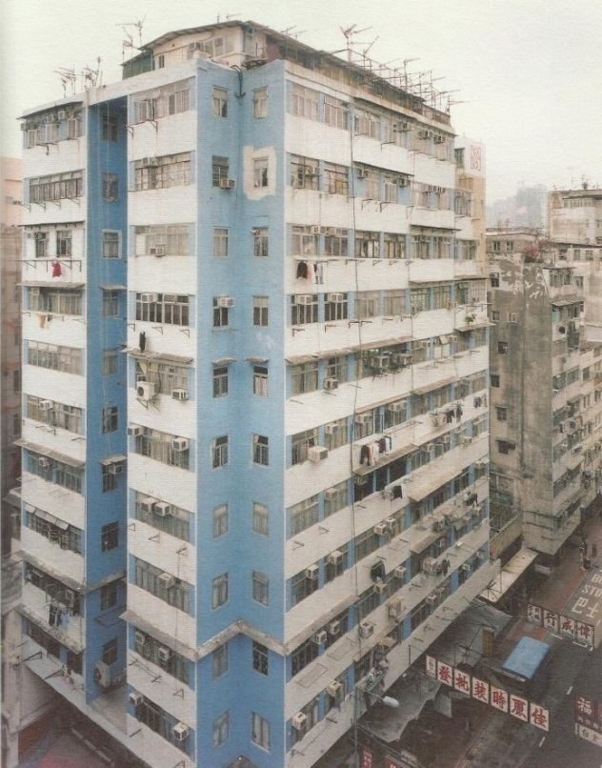
GLOBAL CITIZENSHIP & SOCIAL JUSTICE
HK INFORMAL ROOFTOP COMMUNITIES
Shan Shui Poi Building Example 2
FUNDAMENTALS OF INTERIOR ARCHITECTURAL DESIGN - AN INTRODUCTION
Drawings from Portraits From Above –Wu, Canham

Slide 29
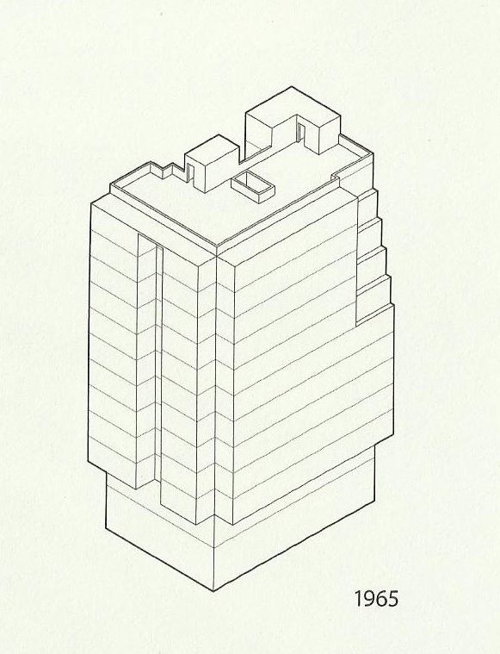
GLOBAL CITIZENSHIP & SOCIAL JUSTICE
HK INFORMAL ROOFTOP COMMUNITIES
FUNDAMENTALS OF INTERIOR ARCHITECTURAL DESIGN - AN INTRODUCTION
Shan Shui Poi Building Example 2
This flat is 635 sq. ft.
Houses immigrant couple from Shenzhen and one child of their six
Three distinct zones of rooftop home: living, entertaining and outdoors
Roof advantages – one side of the unit is living area with bathroom and bedrooms.; the other side is devoted to mahjong (game) with space for up to 24 players and six tables; outside space for storage, laundry lines, dishwashing and basketball
Drawings from Portraits From Above –Wu, Canham

Slide 30
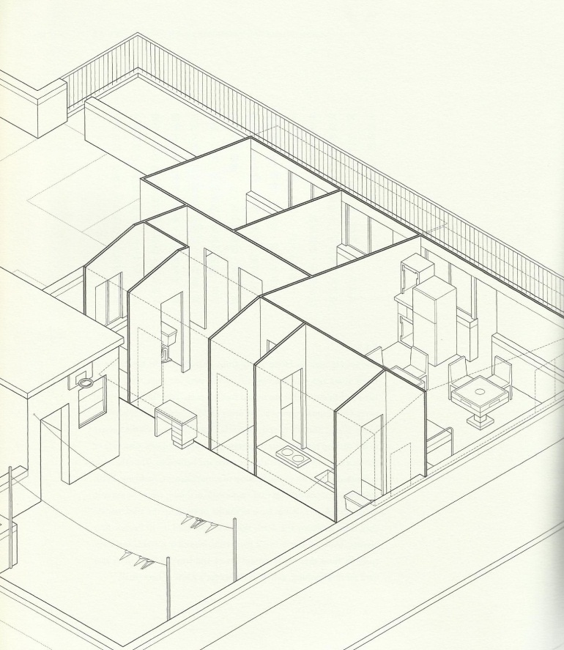
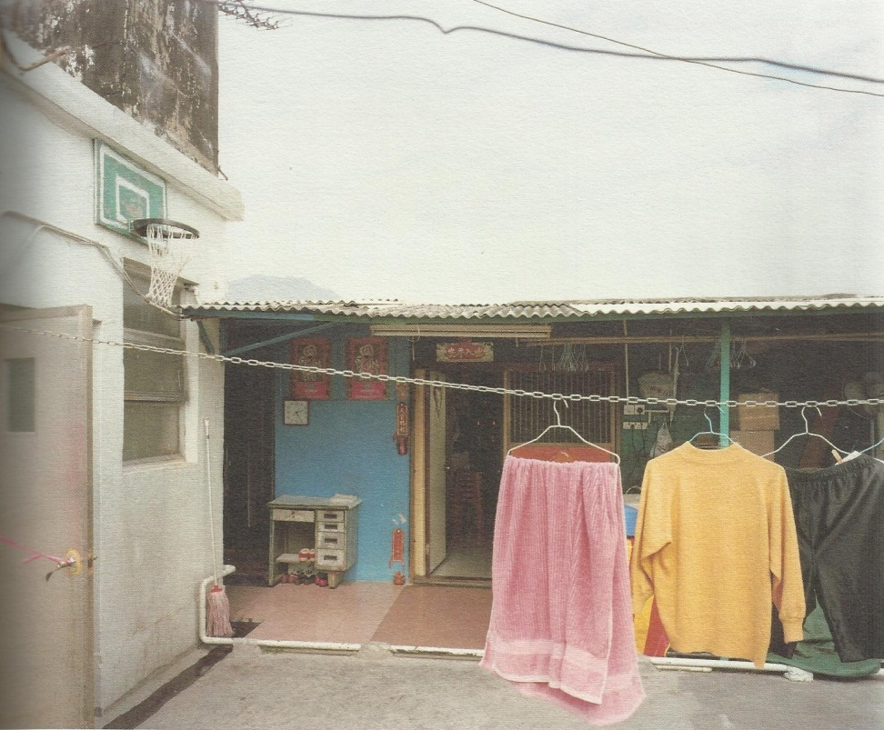
GLOBAL CITIZENSHIP & SOCIAL JUSTICE
HK INFORMAL ROOFTOP COMMUNITIES
Shan Shui Poi Building Example 2
FUNDAMENTALS OF INTERIOR ARCHITECTURAL DESIGN - AN INTRODUCTION
Drawings from Portraits From Above –Wu, Canham

Slide 31
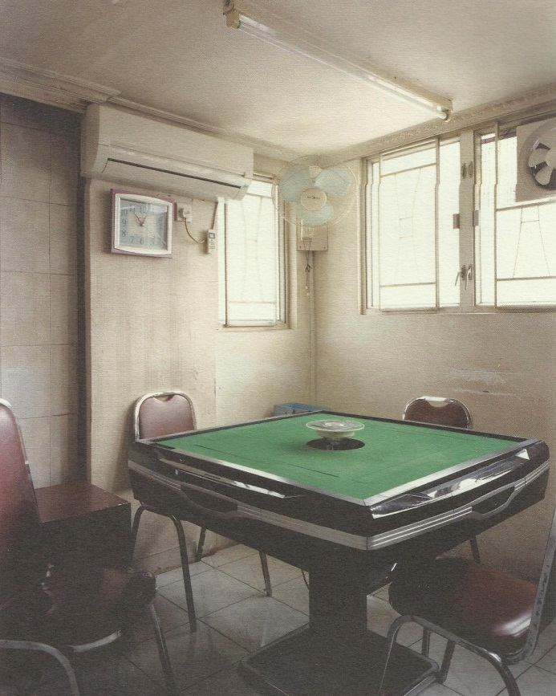
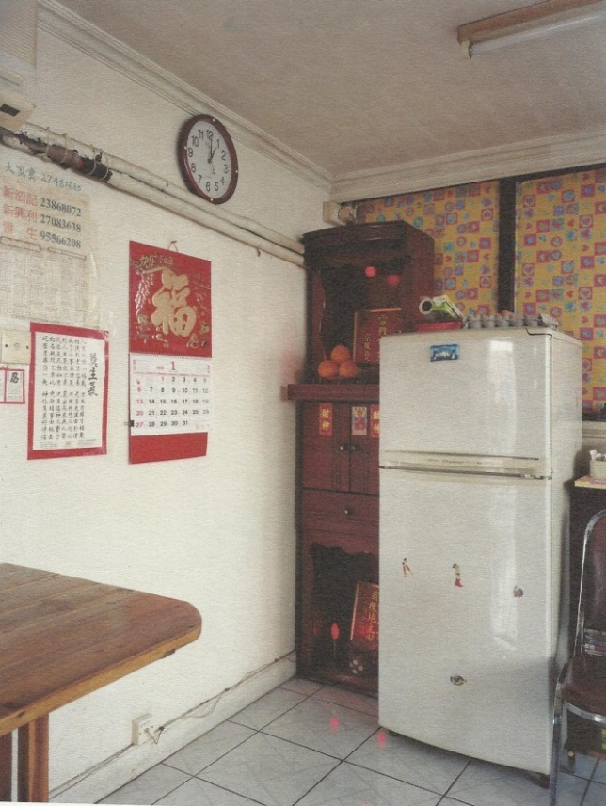
GLOBAL CITIZENSHIP & SOCIAL JUSTICE
HK INFORMAL ROOFTOP COMMUNITIES
Shan Shui Poi Building Example 2
FUNDAMENTALS OF INTERIOR ARCHITECTURAL DESIGN - AN INTRODUCTION

Slide 32
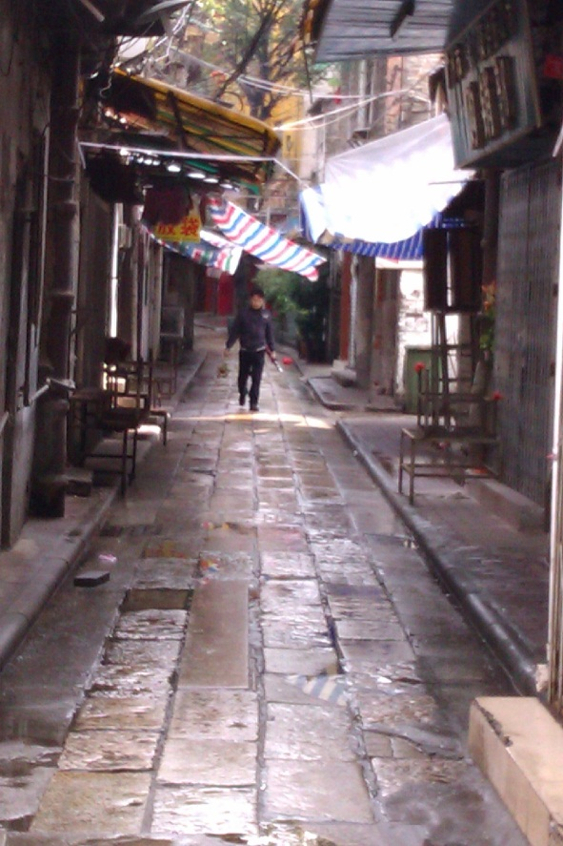
HOW WE TOUCH & CHANGE LIVES
FUNDAMENTALS OF INTERIOR ARCHITECTURAL DESIGN - AN INTRODUCTION
Guangzhou China
EXERCISE – LOOP BACK – DESIGN THINKING IDEATION
“If I’d asked my customers what
they wanted, they’d said a faster horse.”
Henry Ford
344 square feet or 13’ X 26’
Quick prototyping
What are your bothersome functional issues
with your living space now?

Slide 33
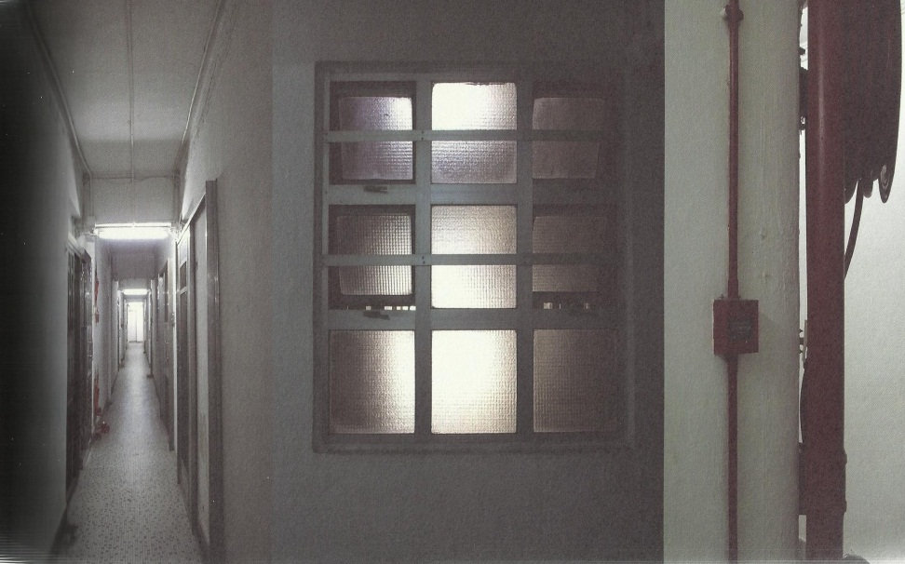
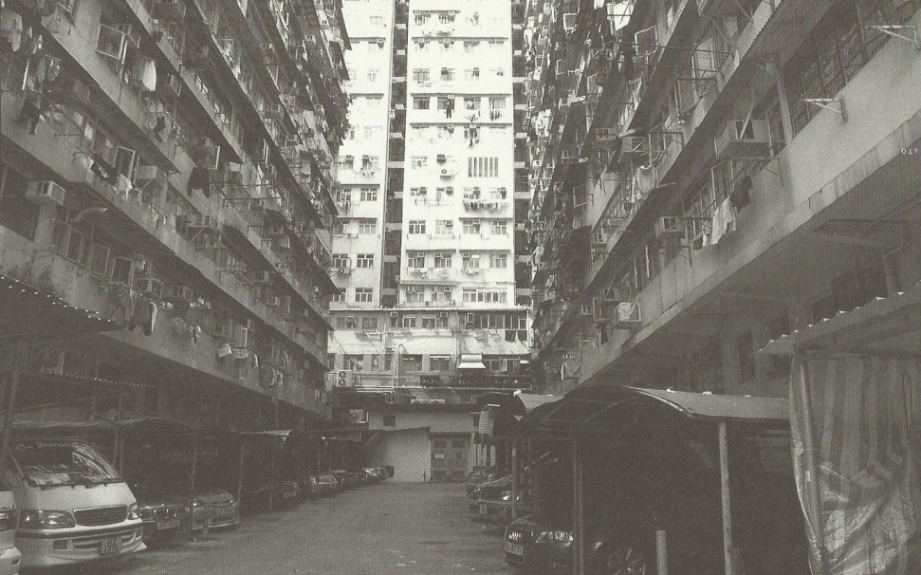
HOW WE TOUCH & CHANGE LIVES
Gary Chang - architect
FUNDAMENTALS OF INTERIOR ARCHITECTURAL DESIGN - AN INTRODUCTION
My 32 m apartment – a 30 year transformation

Slide 34
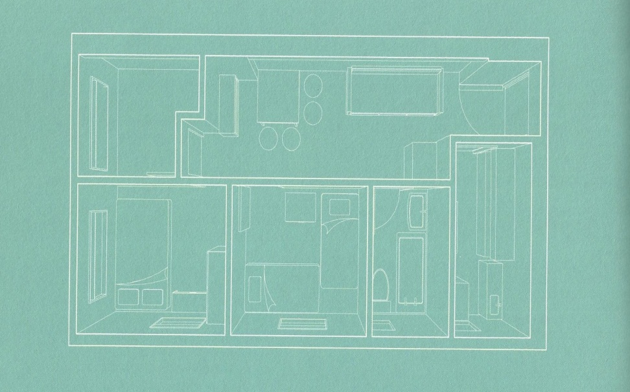
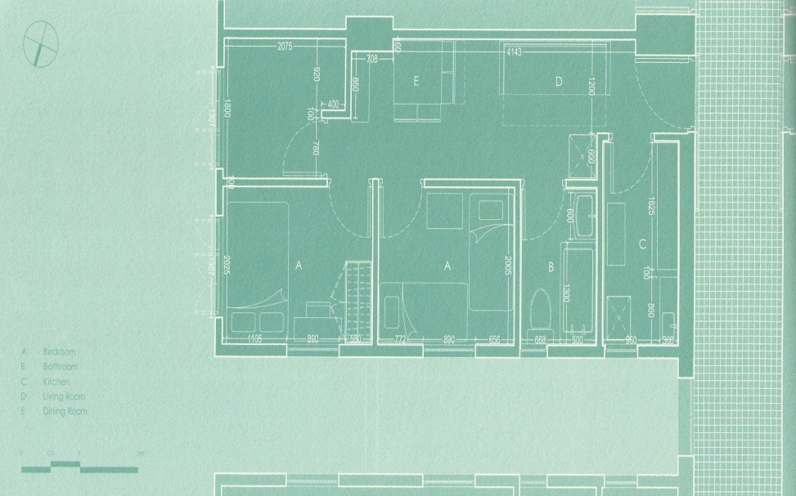
HOW WE TOUCH & CHANGE LIVES
Gary Chang - architect
30 year documentation of family home
Low cost public housing apartment
344 sq. ft. of living space for 6 people
Living in true spirit of cooperation!
FUNDAMENTALS OF INTERIOR ARCHITECTURAL DESIGN - AN INTRODUCTION
My 32 m apartment – a 30 year transformation

Slide 35
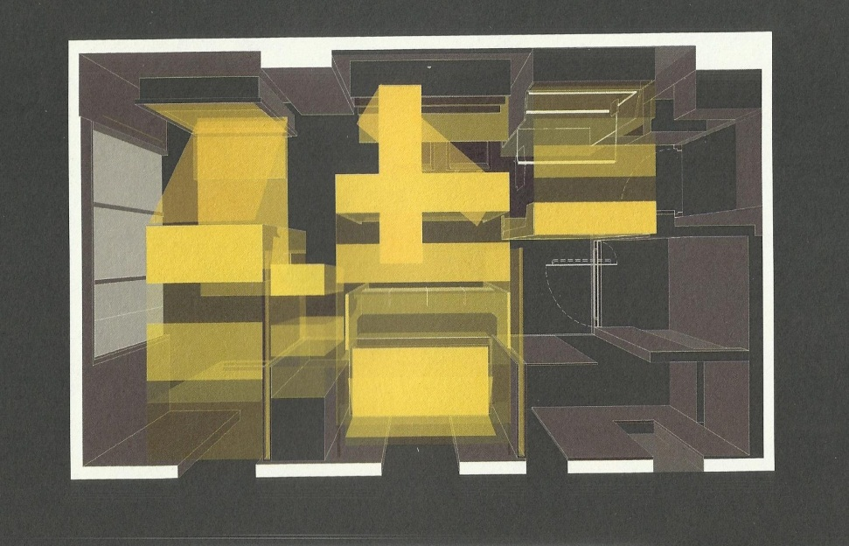
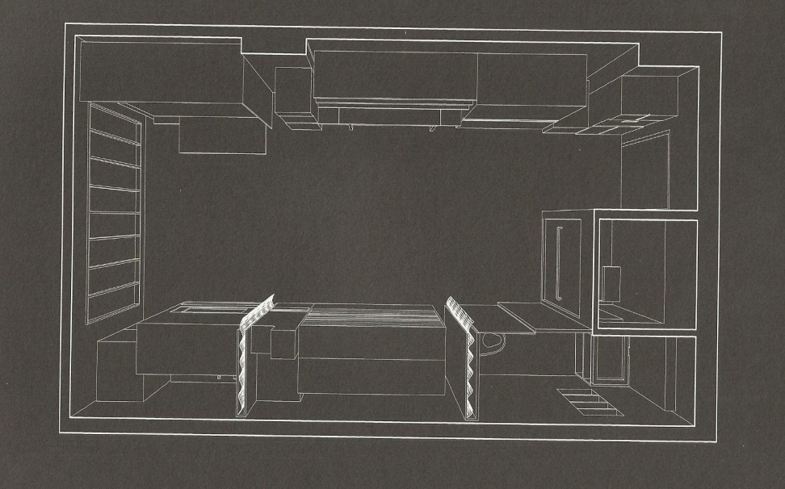
HOW WE TOUCH & CHANGE LIVES
Gary Chang - Domestic Transformer
Luxury of empty space “suitcase home”
Devices for flexibility and change
Functional zones
Sliding wall sections
FUNDAMENTALS OF INTERIOR ARCHITECTURAL DESIGN - AN INTRODUCTION
My 32 m apartment – a 30 year transformation

Slide 36
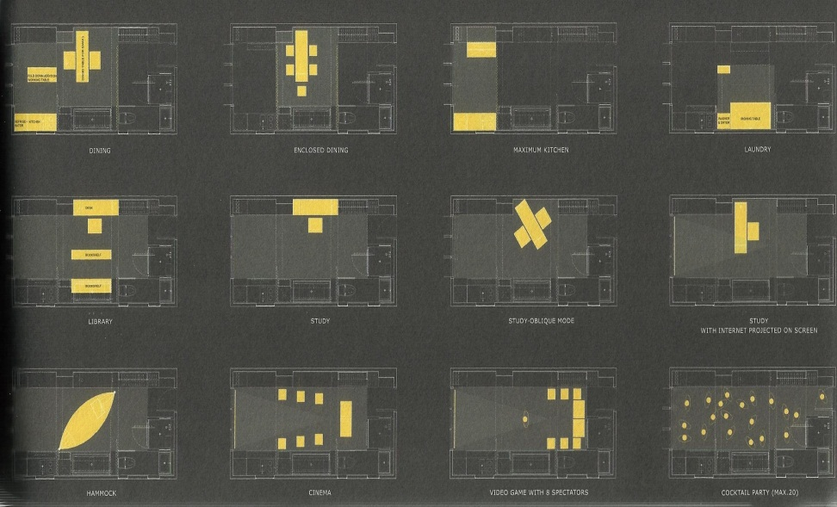
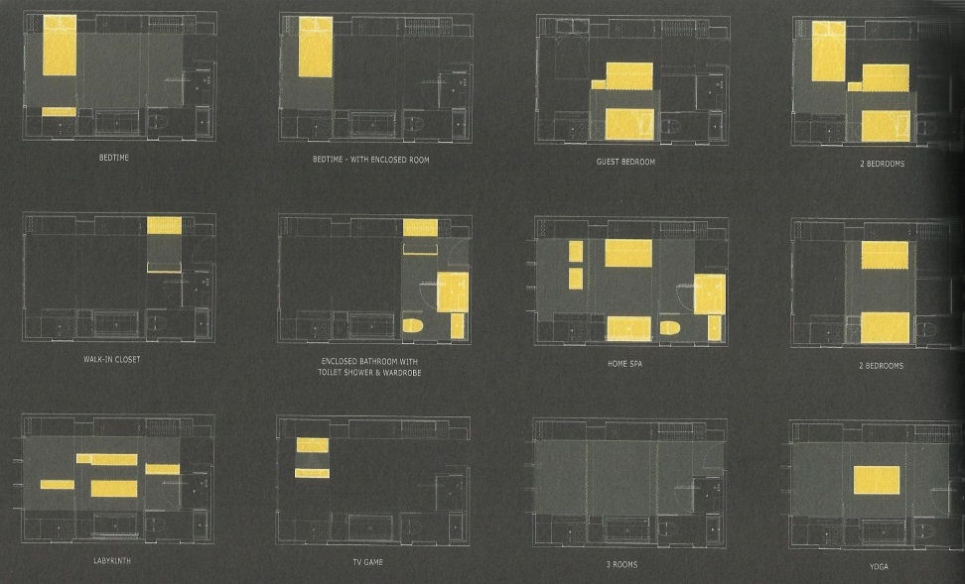
HOW WE TOUCH & CHANGE LIVES
Gary Chang – Domestic Transformer
Apartment may be arranged in
24 different scenarios or functions
FUNDAMENTALS OF INTERIOR ARCHITECTURAL DESIGN - AN INTRODUCTION
My 32 m apartment – a 30 year transformation

Slide 37
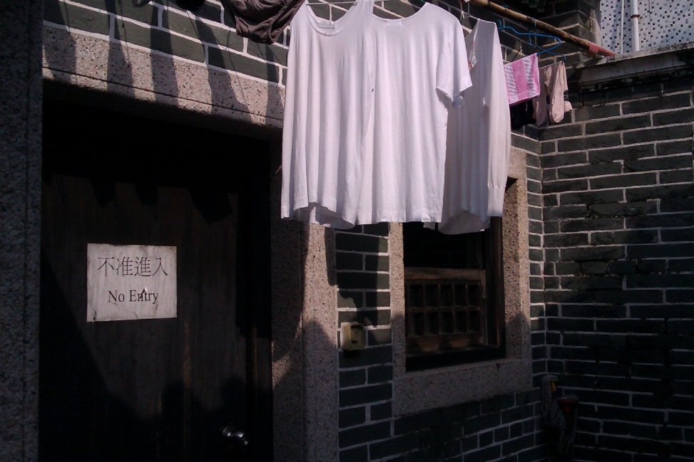
HOW WE TOUCH & CHANGE LIVES
FUNDAMENTALS OF INTERIOR ARCHITECTURAL DESIGN - AN INTRODUCTION
“He who seeks truth shall find beauty. He who seeks beauty shall find vanity.
He who seeks order shall find gratification. He who seeks gratification shall be disappointed.
He who considers himself the servant of his fellow beings shall find the joy of self-expression. He who seeks self-expression shall fall into the pit of arrogance.
Arrogance is incompatible with nature. Through the nature of the universe and the nature of man we shall seek truth.
If we seek truth we shall find beauty.”
Moshe Sofdie - architect
Cheng Chau Island temple Hong Kong

Slide 38

SOURCES
FUNDAMENTALS OF INTERIOR ARCHITECTURAL DESIGN - AN INTRODUCTION
Allen D. Discover Skyscrapers, Discovery Magazine,
12-2011
Caan S. President’s Update, IFI IDI March 2011,
IFI Interiors Declaration
Chang G. My 32m apartment - A 30 year transformation, 2008
Ehrenhalt A. The great migration inversion of the American city, 2012
Gordon R.P. Residential Design Studio, 2011
Hong Kong Culture Heritage Studies & Promotion Association
Rose, C. Interview with Moshe Sodie, 2011
Santa Monica College website, Global Citizenship
Stanford Social Innovation Review – informing & inspiring leaders of social change
TED presentation by Moshe Sodie, 2002
US Department of State (www.state.gov),
100,000 Strong Initiative, 4-25-2012
Wikipedia population density information, 4-24-2012
Wu R. Canham S. Portraits from above – Hong Kong’s Informal Rooftop Communities, 2009
Chang Chau Island Hong Kong

